Slide 1
Configuring and Testing Your Network
Network Fundamentals – Chapter 11

Slide 2
Objectives
Define the role of the Internetwork Operating System (IOS)
Use Cisco CLI commands to perform basic router and switch configuration and verification
Given a network addressing scheme, select, apply, and verify appropriate addressing parameters to a host
Use common utilities to verify network connectivity between hosts
Use common utilities to establish a relative performance baseline for the network

Slide 3
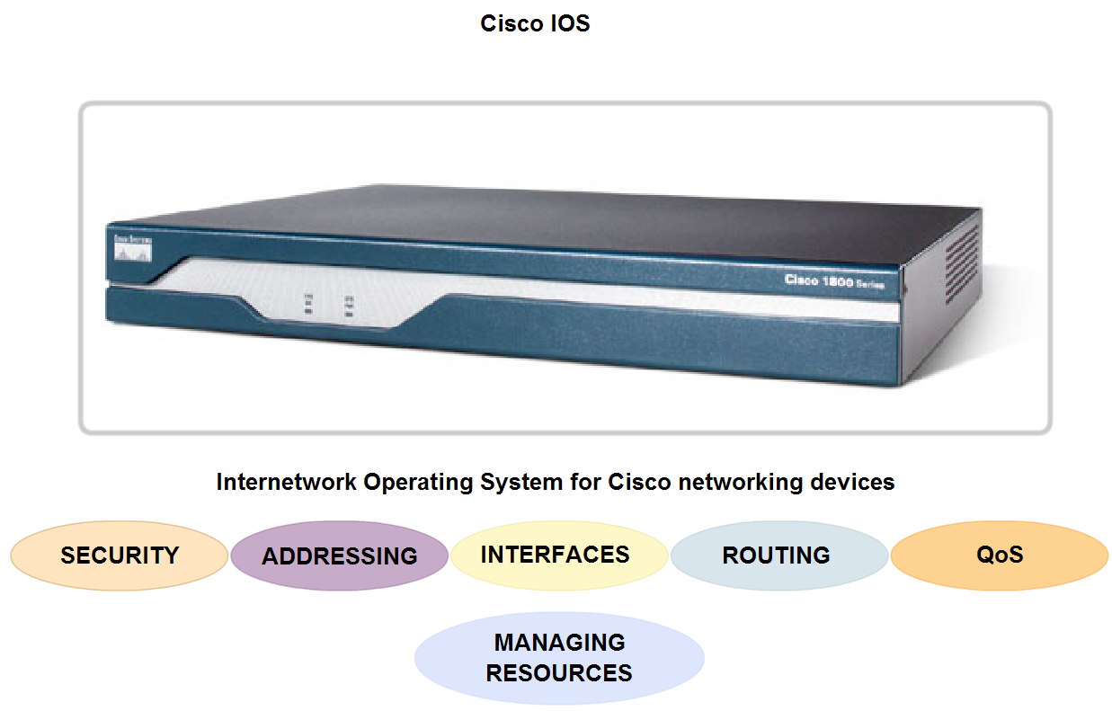
Role of Internetwork Operating System (IOS)
Identify several classes of devices that have IOS embedded

Slide 4
IOS Introduction
The Cisco IOS is used for most Cisco devices regardless of the size and type of the device.
It is used for routers, LAN switches, small Wireless Access Points, large routers with dozens of interfaces, and many other devices.
The Cisco IOS provides devices with the following network services:
Basic routing and switching functions
Reliable and secure access to networked resources
Network scalability
The IOS operational details vary on different internetworking devices, depending on the device's purpose and feature set.

Slide 5
IOS Introduction
The IOS file itself is several megabytes in size and is stored in a semi-permanent memory area called flash. Flash memory provides non-volatile storage.
This means that the contents of the memory are not lost when the device loses power.
Even though the contents are not lost they can be changed or overwritten if needed.
Using flash memory allows the IOS to be upgraded to newer versions or to have new features added.
In many router architectures, the IOS is copied into RAM when the device is powered on and the IOS runs from RAM when the device is operating.
This function increases the performance of the device.

Slide 6
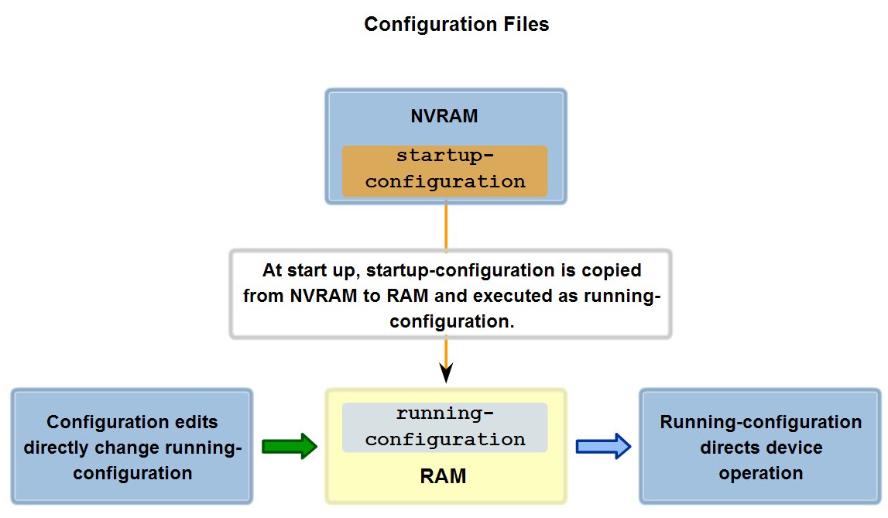
Role of Internetwork Operating System (IOS)
Define the purpose of startup config.

Slide 7
Start-up Configuration
The startup configuration file (startup-config) is used during system startup to configure the device.
The startup configuration file or startup-config file is stored in non-volatile RAM (NVRAM).
Since NVRAM is non-volatile, when the Cisco device is turned off, the file remains intact.
The startup-config files are loaded into RAM each time the router is started or reloaded.
Once the configuration file is loaded into RAM, it is considered the running configuration or running-config.

Slide 8
Running-Config
The running configuration is modified when the network administrator performs device configuration.
Changes to the running configuration will immediately affect the operation of the Cisco device.
After making any changes, the administrator has the option of saving those changes back to the startup-config file so that they will be used the next time the device restarts.
Because the running configuration file is in RAM, it is lost if the power to the device is turned off or if the device is restarted.
Changes made to the running-config file will also be lost if they are not saved to the startup-config file before the device is powered down.

Slide 9
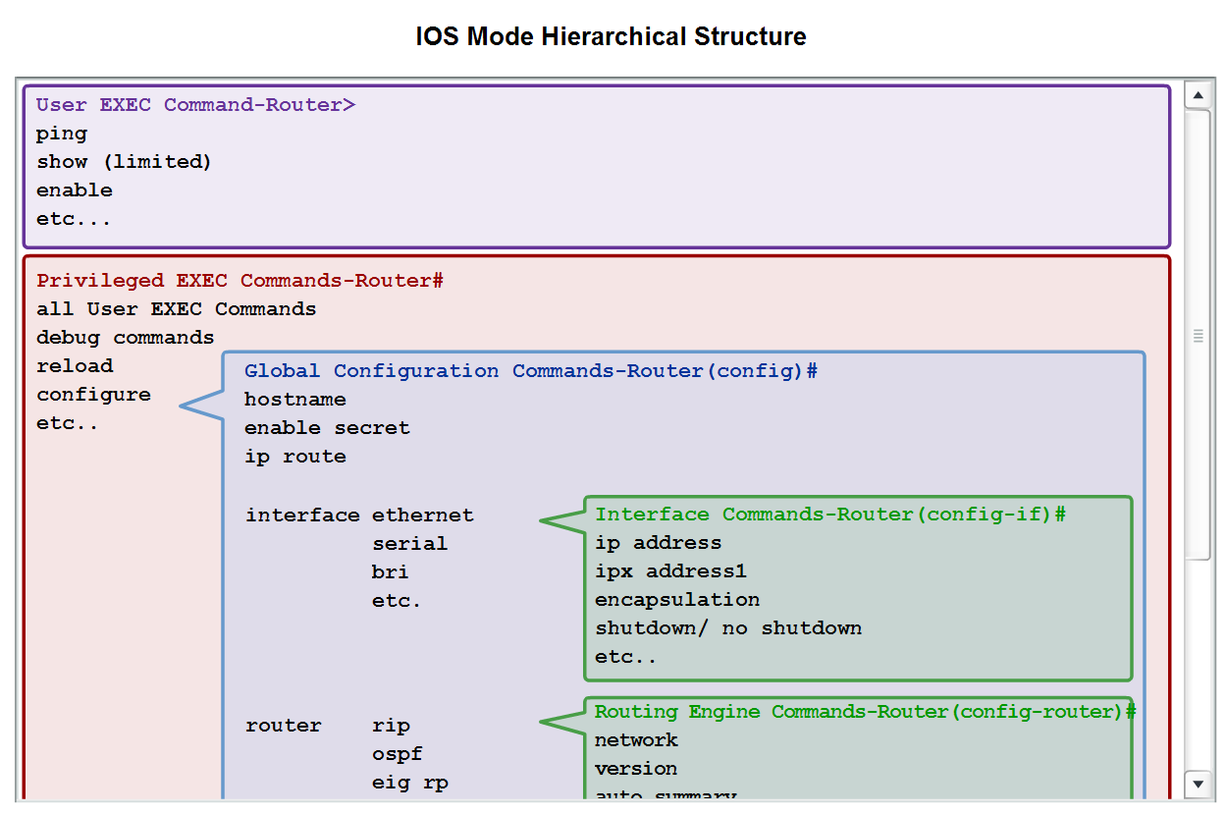
Role of Internetwork Operating System (IOS)
Recognize that Cisco IOS is modal and describe the implications of modes.

Slide 10
Router Modes
In order from top to bottom, the major modes are:
User executive mode
Privileged executive mode
Global configuration mode
Other specific configuration modes
Each mode is used to accomplish particular tasks and has a specific set of commands that are available when in that mode.
For example, to configure a router interface, the user must enter interface configuration mode.
All configurations that are entered in interface configuration mode apply only to that interface.
Some commands are available to all users; others can be executed only after entering the mode in which that command is available.
Each mode is distinguished with a distinctive prompt, and only commands that are appropriate for that mode are allowed.

Slide 11
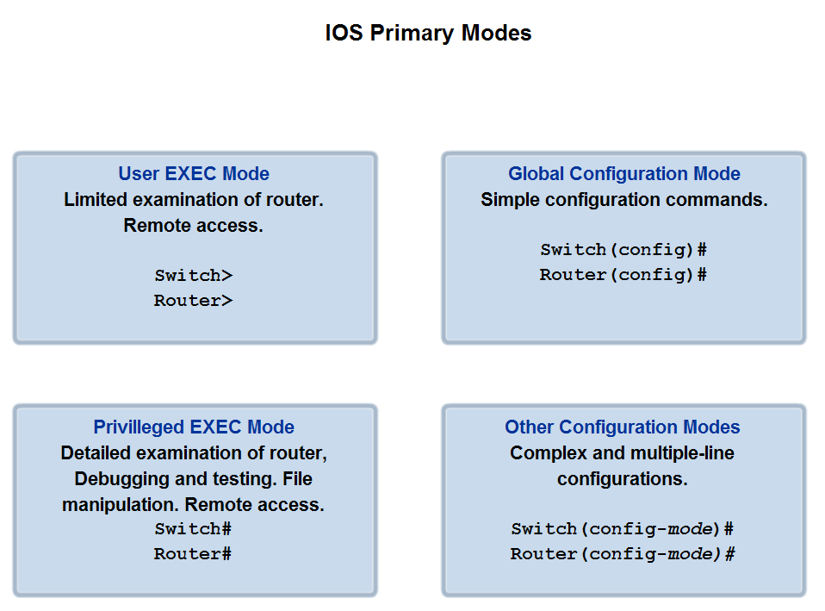
Role of Internetwork Operating System (IOS)
Define the different modes and identify the mode prompts in the CLI

Slide 12
Primary Modes:
The user executive mode: has limited capabilities but is useful for some basic operations. The user EXEC mode is at the top of the modal hierarchical structure. This mode is the first entrance into the CLI of an IOS router.
The user EXEC mode allows only a limited number of basic monitoring commands. This is often referred to as view-only mode. The user EXEC level does not allow the execution of any commands that might change the configuration of the device.
Privileged Exec Mode:
The execution of configuration and management commands requires that the network administrator use the privileged EXEC mode, or a specific mode further down the hierarchy.
The privileged EXEC mode can be identified by the prompt ending with the # symbol.
Switch#
By default, privileged EXEC does not require authentication. It is a good practice to ensure that authentication is configured.

Slide 13
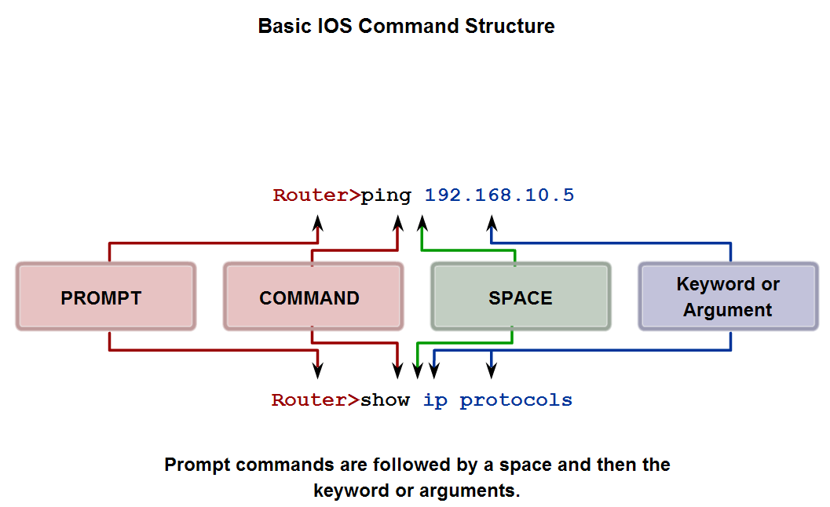
Role of Internetwork Operating System (IOS)
Identify the basic command structure for IOS commands

Slide 14
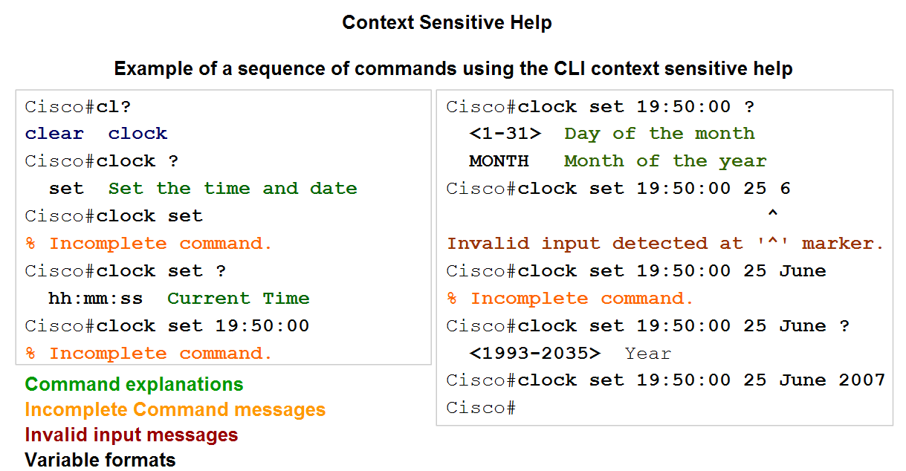
Role of Internetwork Operating System (IOS)
Identify the types of help and feedback available while using IOS and use these features to get help, take shortcuts and ascertain success

Slide 15
Context-Sensitive Help
The context-sensitive help provides a list of commands and the arguments associated with those commands within the context of the current mode.
To access context-sensitive help, enter a question mark, ?, at any prompt. There is an immediate response without the need to use the <Enter> key.
One use of context-sensitive help is to get a list of available commands.
This can be used when you are unsure of the name for a command or you want to see if the IOS supports a particular command in a particular mode.
Another use of context-sensitive help is to display a list of commands or keywords that start with a specific character or characters. For example, enter sh? to get a list of commands that begin with the character sequence sh.

Slide 16
Command Syntax Check Help
When a command is submitted by pressing the <Enter> key, the command line interpreter parses the command from left to right to determine what action is being requested.
The IOS generally only provides negative feedback. If the interpreter understands the command, the requested action is executed and the CLI returns to the appropriate prompt.
However, if the interpreter cannot understand the command being entered, it will provide feedback describing what is wrong with the command.
There are three different types of error messages:
Ambiguous command
Incomplete command
Incorrect command

Slide 17
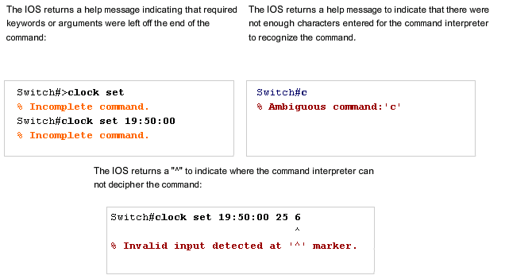
Command Syntax Help

Slide 18
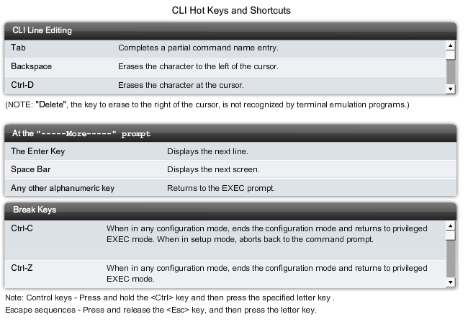
Hot Keys and Shortcuts

Slide 19
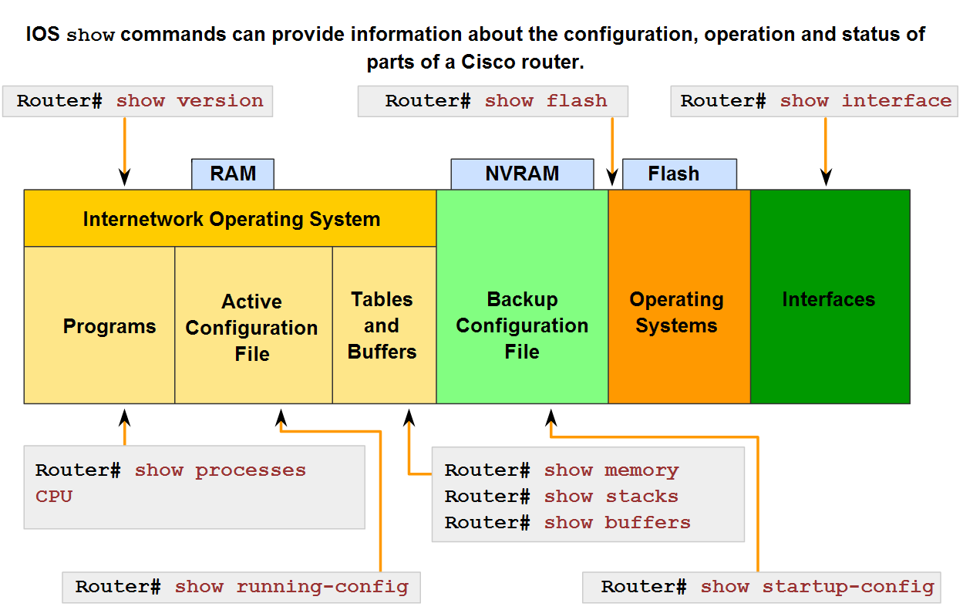
Role of Internetwork Operating System (IOS)
Identify the purpose of the show command and several of its variations

Slide 20
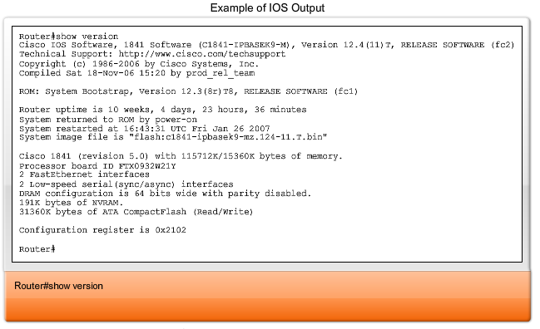
Show Version

Slide 21
Show Version Output
Some of the information shown from this command are:
Software Version - IOS software version (stored in flash)
Bootstrap Version - Bootstrap version (stored in Boot ROM)
System up-time - Time since last reboot
System restart info - Method of restart (e.g., power cycle, crash)
Software image name - IOS filename stored in flash
Router Type and Processor type - Model number and processor type
Memory type and allocation (Shared/Main) - Main Processor RAM and Shared Packet I/O buffering
Software Features - Supported protocols / feature sets
Hardware Interfaces - Interfaces available on router
Configuration Register - Sets bootup specifications, console speed setting, and related parameters.

Slide 22
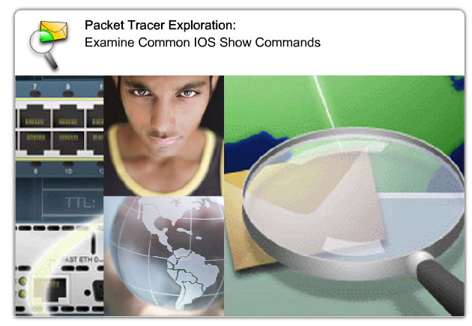
Packet Tracer Lab

Slide 23
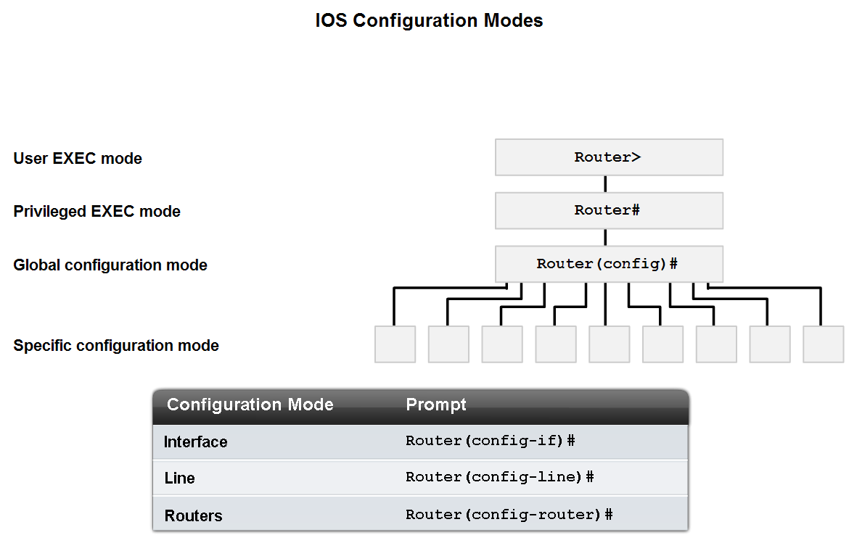
Role of Internetwork Operating System (IOS)
Identify several of the configuration modes, their purpose and their associated prompt

Slide 24
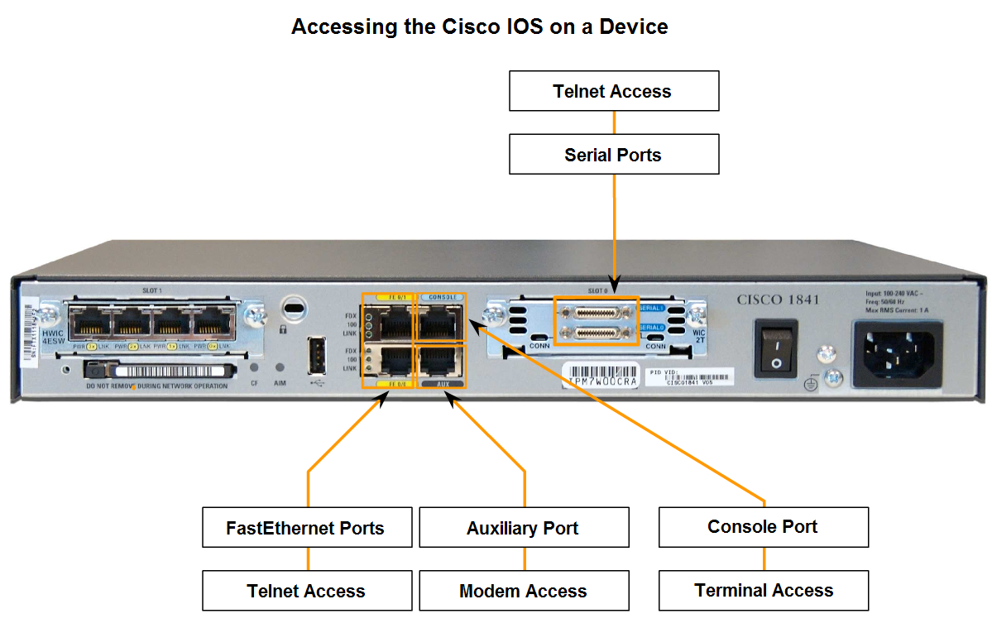
Role of Internetwork Operating System (IOS)
Use the CLI to access various IOS configuration modes on a device

Slide 25
CLI Uses
The CLI can be accessed through a console session, also known as the CTY line. A console uses a low speed serial connection to directly connect a computer or terminal to the console port on the router or switch.
The console port is a management port that provides out-of-band access to a router.
The console port is accessible even if no networking services have been configured on the device. The console port is often used to access a device when the networking services have not been started or have failed.
Examples of console use are:
The initial configuration of the network device
Disaster recovery procedures and troubleshooting where remote access is not possible
Password recovery procedures

Slide 26
Telnet
A method for remotely accessing a CLI session is to telnet to the router. Unlike the console connection, Telnet sessions require active networking services on the device.
The network device must have at least one active interface configured with a Layer 3 address, such as an IPv4 address.
Cisco IOS devices include a Telnet server process that launches when the device is started. The IOS also contains a Telnet client.
A host with a Telnet client can access the vty sessions running on the Cisco device.
For security reasons, the IOS requires that the Telnet session use a password, as a minimum authentication method. The methods for establishing logins and passwords will be discussed in a later section.

Slide 27
SSH
The Secure Shell (SSH) protocol is a more secure method for remote device access. This protocol provides the structure for a remote login similar to Telnet, except that it utilizes more secure network services.
SSH provides stronger password authentication than Telnet and uses encryption when transporting session data.
The SSH session encrypts all communications between the client and the IOS device. This keeps the user ID, password, and the details of the management session private.
As a best practice, always use SSH in place of Telnet whenever possible.

Slide 28
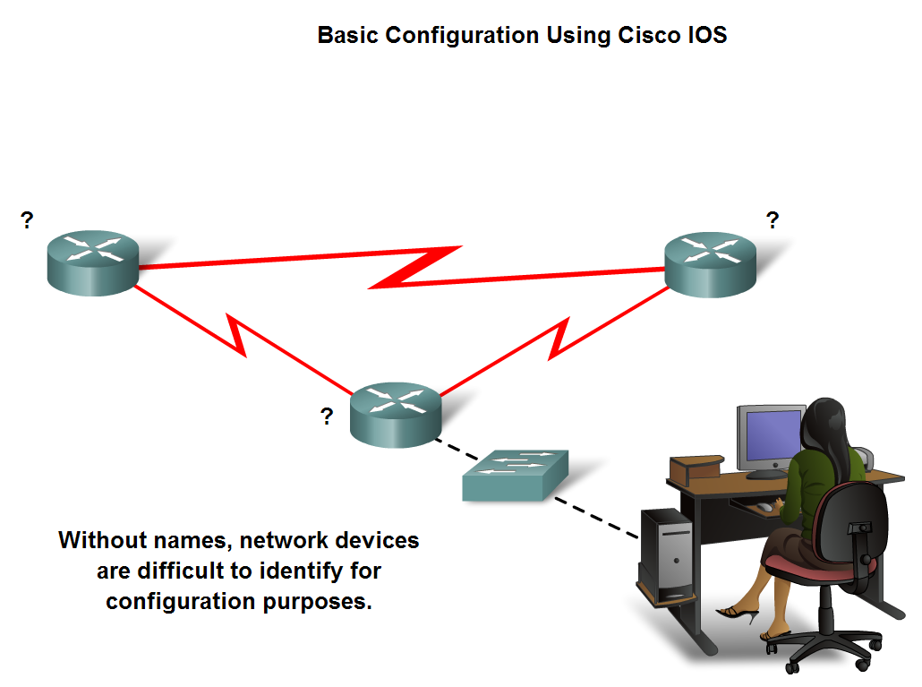
Use Cisco CLI Commands to Perform Basic Router & Switch Configuration and Verification
Explain the reasons for naming devices.

Slide 29
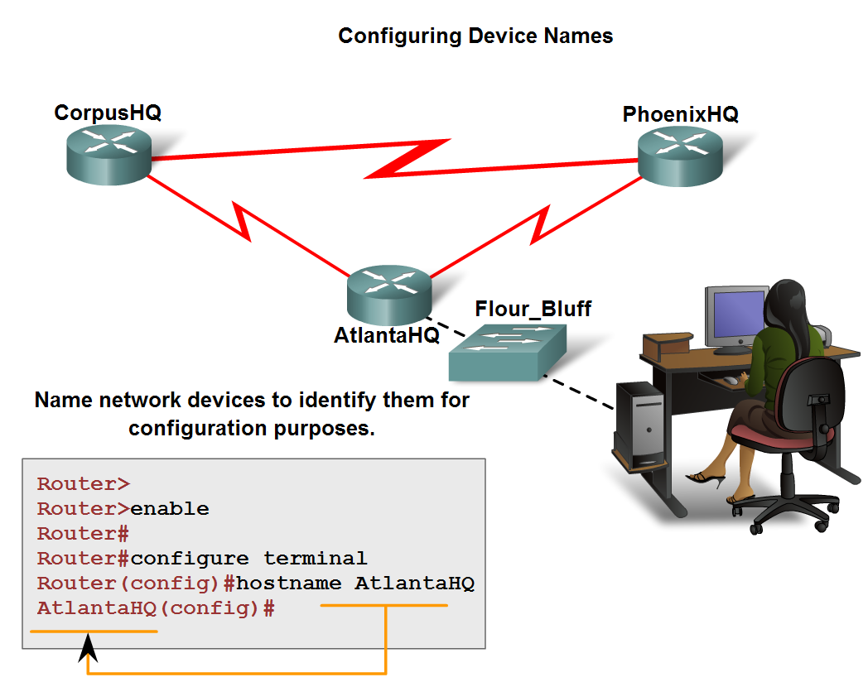
Use Cisco CLI Commands to Perform Basic Router & Switch Configuration and Verification
Describe two common approaches to establishing naming conventions

Slide 30
Passwords
The IOS uses hierarchical modes to help with device security. As part of this security enforcement, the IOS can accept several passwords to allow different access privileges to the device.
The passwords introduced here are:
Console password - limits device access using the console connection
Enable password - limits access to the privileged EXEC mode
Enable secret password - encrypted, limits access to the privileged EXEC mode
VTY password - limits device access using Telnet

Slide 31
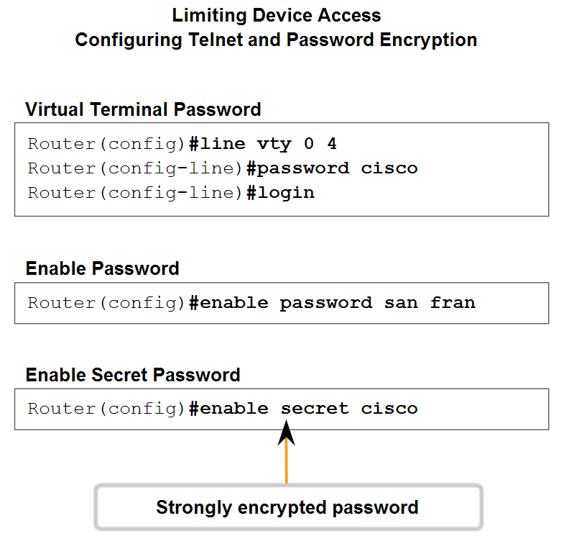
Use Cisco CLI Commands to Perform Basic Router & Switch Configuration and Verification
Describe several ways in which access to a device configuration can be limited

Slide 32
Additional Security
Enable Secret:
To provide additional security, use the enable password command or the enable secret command. Either of these commands can be used to establish authentication before accessing privileged EXEC (enable) mode.
VTY:
The vty lines allow access to a router via Telnet. By default, many Cisco devices support five VTY lines that are numbered 0 to 4.
A password needs to be set for all available vty lines. The same password can be set for all connections. However, it is often desirable that a unique password be set for one line to provide a fall-back for administrative entry to the device if the other connections are in use.

Slide 33
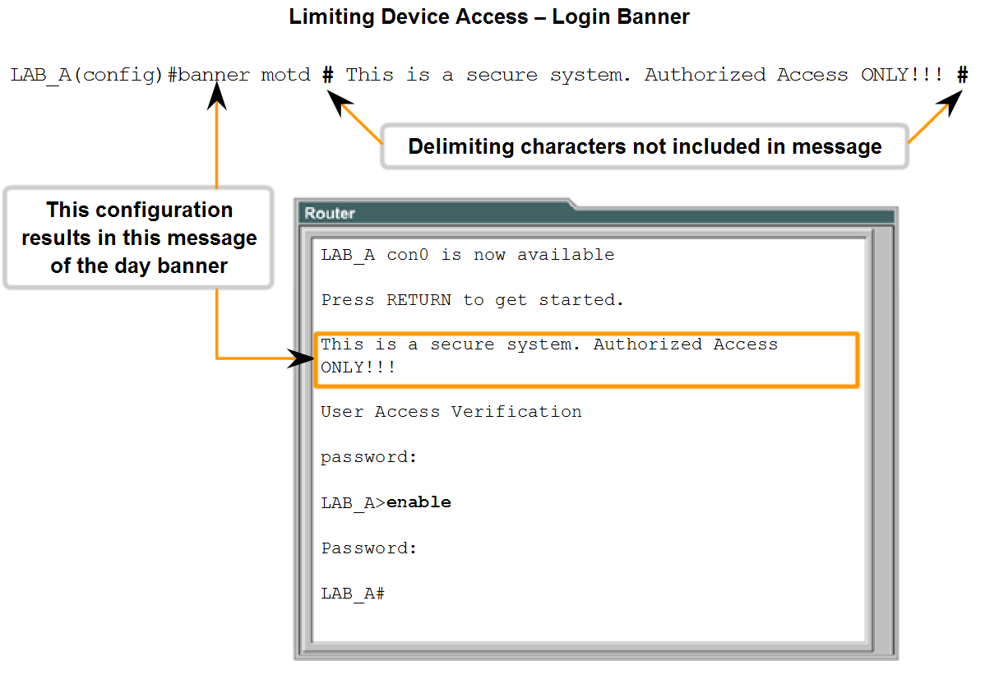
Use Cisco CLI Commands to Perform Basic Router & Switch Configuration and Verification
Use the CLI to set passwords and add banners to a device

Slide 34
MOTD - Banners
Banners can be an important part of the legal process in the event that someone is prosecuted for breaking into a device. Some legal systems do not allow prosecution, or even the monitoring of users, unless a notification is visible.
The exact content or wording of a banner depends on the local laws and corporate policies. Here are some examples of information to include in a banner:
"Use of the device is specifically for authorized personnel."
"Activity may be monitored."
"Legal action will be pursued for any unauthorized use."

Slide 35
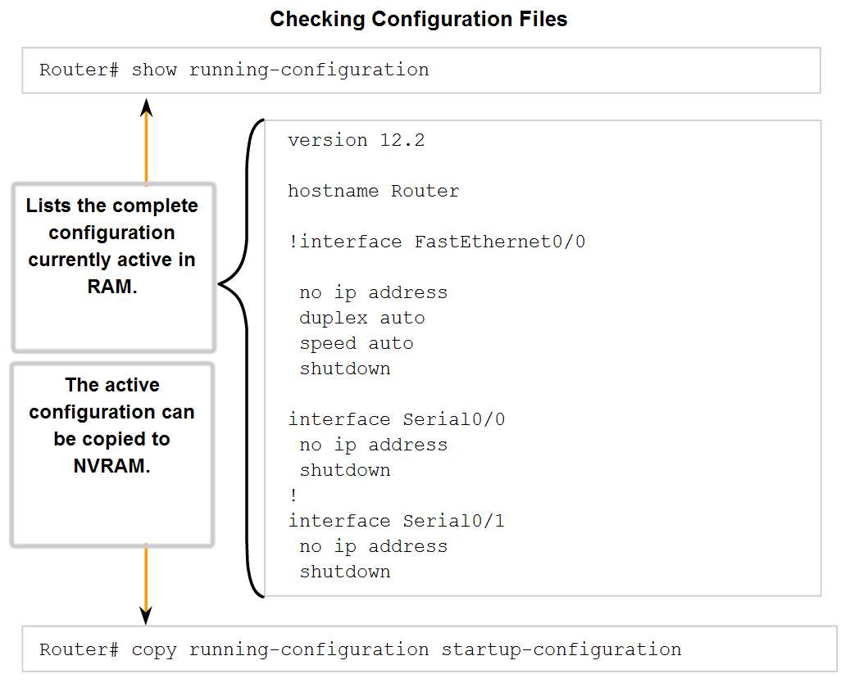
Use Cisco CLI Commands to Perform Basic Router & Switch Configuration and Verification
Trace the steps used to examine the startup config, make changes to config, and replace the startup config with the running config

Slide 36
Show Run – Copy Run Start
Before committing to the changes, use the appropriate show commands to verify the device's operation. As shown in the figure, the show running-config command can be used to see a running configuration file.
When the changes are verified to be correct, use the copy running-config startup-config command at the privileged EXEC mode prompt. The following example shows the command:
If the changes made to the running configuration do not have the desired effect, it may become necessary to restore the device to its previous configuration.
Assuming that we have not overwritten the startup configuration with the changes, we can replace the running configuration with the startup configuration.
This is best done by restarting the device using the reload command at the privileged EXEC mode prompt.

Slide 37
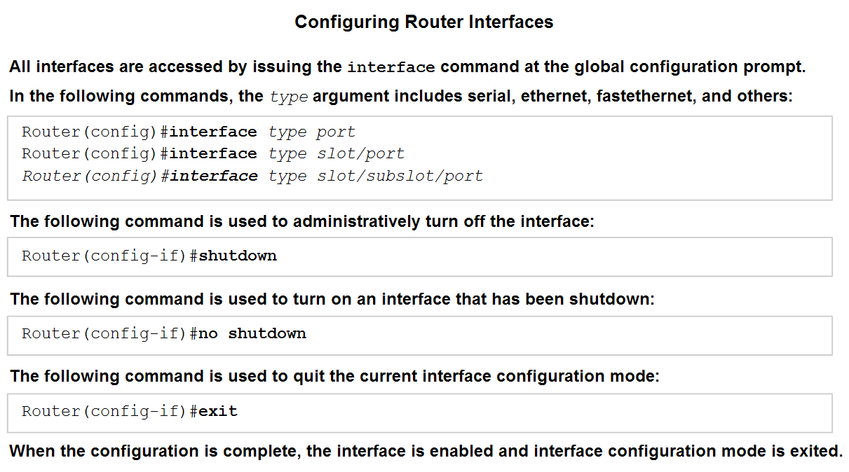
Use Cisco CLI Commands to Perform Basic Router & Switch Configuration and Verification
Identify the role of a router in a network.

Slide 38
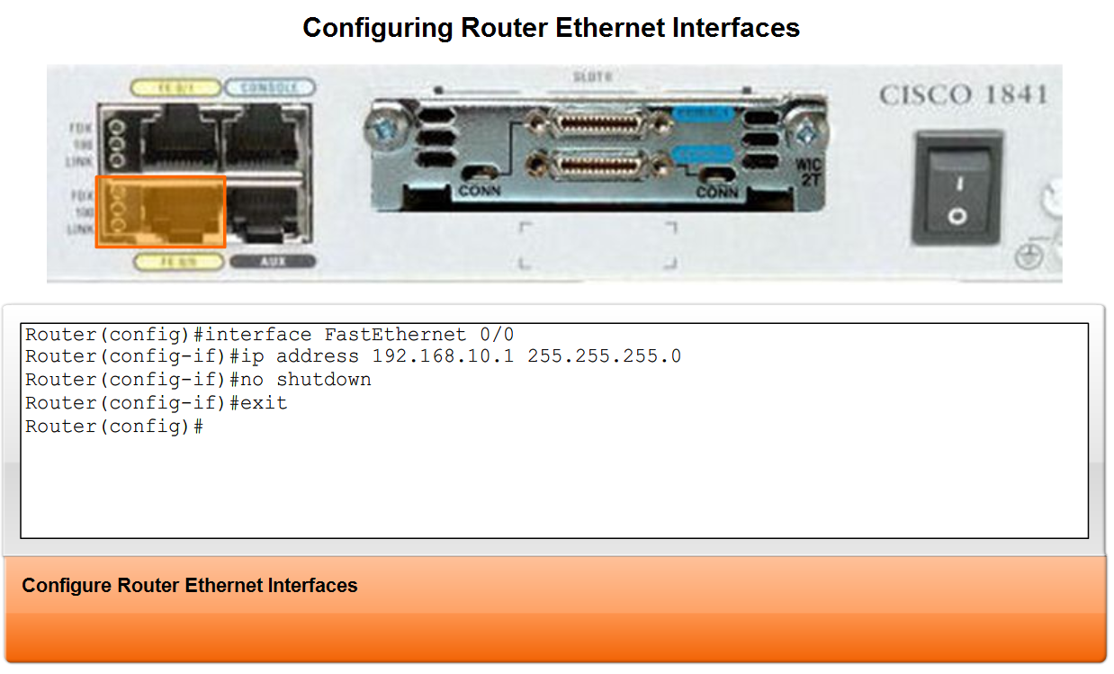
Use Cisco CLI Commands to Perform Basic Router & Switch Configuration and Verification
Describe the purpose of having multiple interfaces in one router

Slide 39
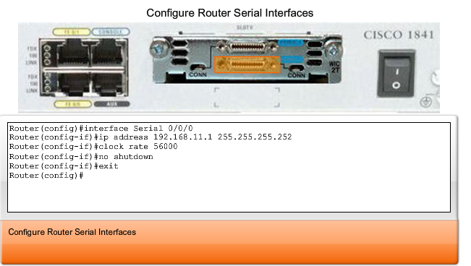
Serial Interface

Slide 40
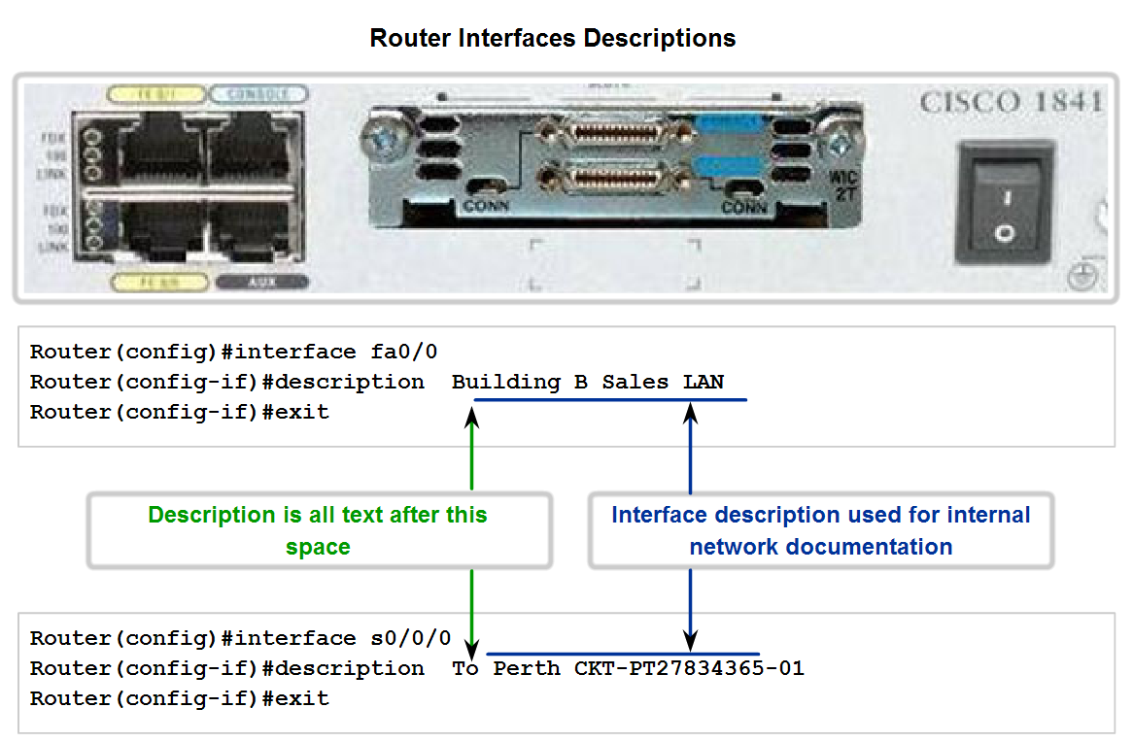
Use Cisco CLI Commands to Perform Basic Router & Switch Configuration and Verification
Explain the purpose of assigning interface descriptions to a router

Slide 41
Interface Descriptions
As the hostname helps to identify the device on a network, an interface description indicates the purpose of the interface.
A description of what an interface does or where it is connected should be part of the configuration of each interface. This description can be useful for troubleshooting.
The interface description will appear in the output of these commands: show startup-config, show running-config, and show interfaces.
For example, this description provides valuable information about the purpose of the interface:
This interface is the gateway for the administration LAN. A description can assist in determining the devices or locations connected to the interface

Slide 42
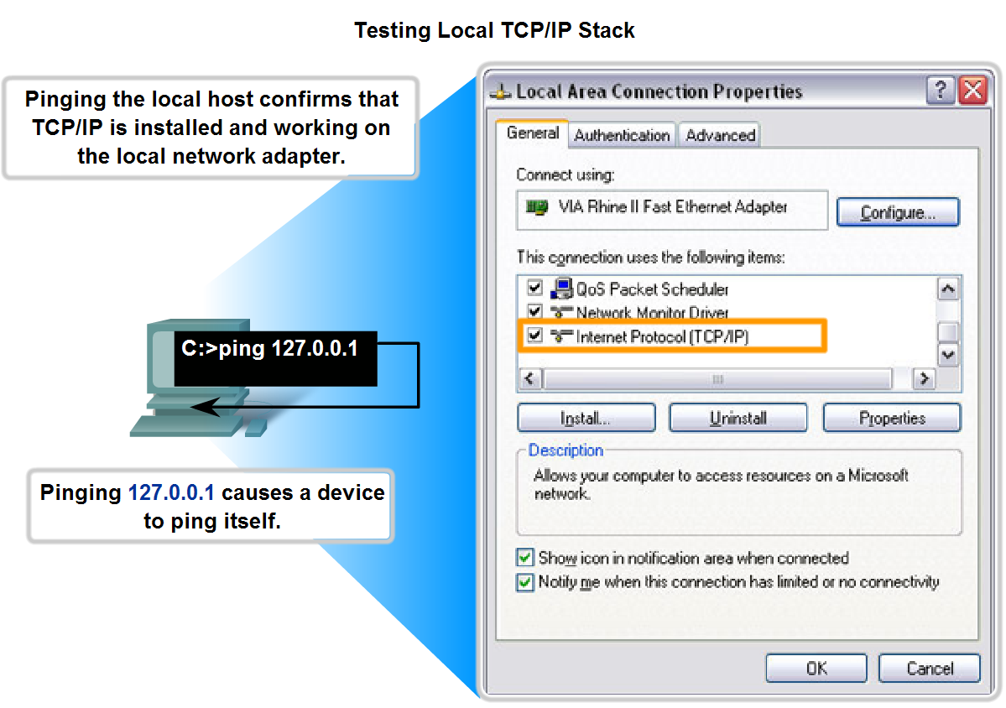
Select, Apply, and Verify Appropriate Addressing Parameters to a Host
Given a type of host and a master addressing scheme, trace the steps for assigning host parameters to a host

Slide 43
PING Command
The ping command in a planned sequence of steps to establish valid connections, starting with the individual device and then extending to the LAN and, finally, to remote networks.
By using the ping command in this ordered sequence, problems can be isolated.
The ping command will not always pinpoint the nature of the problem, but it can help to identify the source of the problem, an important first step in troubleshooting a network failure.
The ping command provides a method for checking the protocol stack and IPv4 address configuration on a host.
There are additional tools that can provide more information than ping, such as Telnet or Trace, which will be discussed in more detail later.

Slide 44
Ping Indicators
The "!" (exclamation mark) indicates that the ping completed successfully and verifies Layer 3 connectivity.
The "." (period) can indicate problems in the communication. It may indicate connectivity problem occurred somewhere along the path. It also may indicate a router along the path did not have a route to the destination and did not send an ICMP destination unreachable message. It also may indicate that ping was blocked by device security.
The "U" indicates that a router along the path did not have a route to the destination address and responded with an ICMP unreachable message.

Slide 45
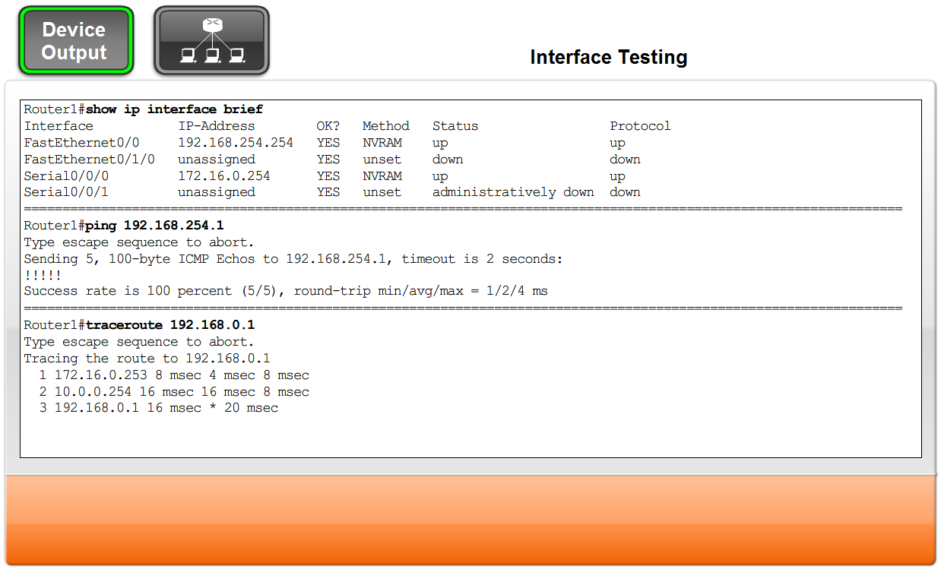
Select, Apply, and Verify Appropriate Addressing Parameters to a Host
Trace the steps for using ipconfig/ifconfig to verify host parameter assignments and for using ping to test assignments

Slide 46
Show IP Interface Brief
One of the most used commands is the show ip interface brief command.
This provides a more abbreviated output than the show ip interface command. This provides a summary of the key information for all the interfaces.
Looking at the Router 1 figure, we can see that this output shows all interfaces attached on the router, the IP address, if any, assigned to each interface, and the operational status of the interface.
Looking at the line for the FastEthernet 0/0 interface, we see that the IP address is 192.168.254.254.
Looking at the last two columns, we can see the Layer 1 and Layer 2 status of the interface. The up in the Status column shows that this interface is operational at Layer 1.
The up in the Protocol column indicates that the Layer 2 protocol is operational.

Slide 47
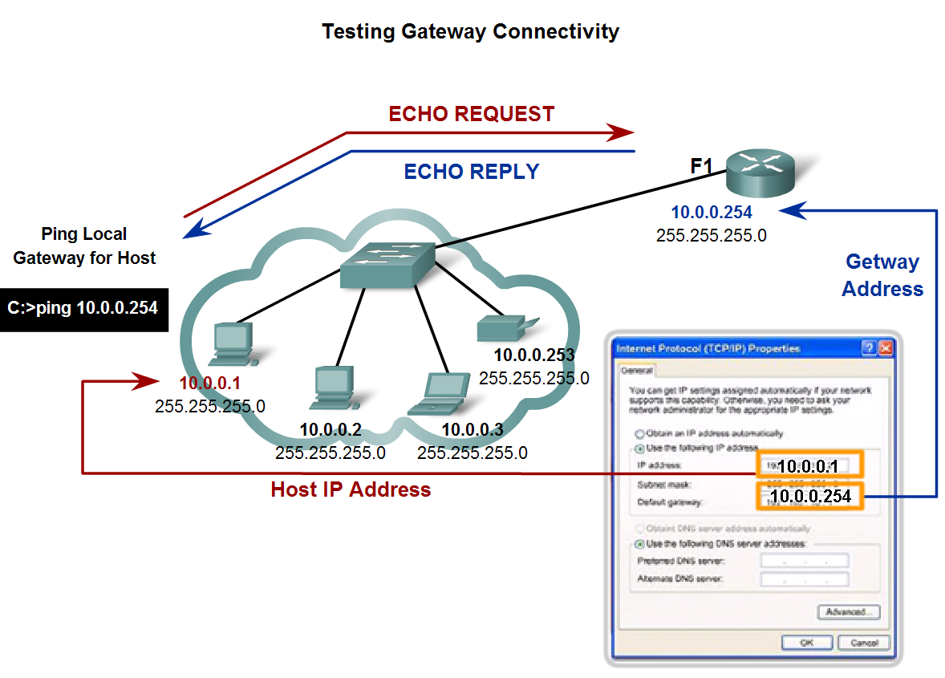
Use Common Utilities to Verify Network Connectivity Between Hosts
Use the ping command in the CLI to determine if the IP protocol is operational on a local host

Slide 48
Testing the Gateway
The gateway IPv4 address should be readily available in the network documentation, but if it is not available, use the ipconfig command to discover the gateway IP address.
If the gateway test fails, back up one step in the sequence and test another host in the local LAN to verify that the problem is not the source host.
Then verify the gateway address with the network administrator to ensure that the proper address is being tested.
If all devices are configured properly, check the physical cabling to ensure that it is secure and properly connected. Keep an accurate record of what attempts have been made to verify connectivity. This will assist in solving this problem and, perhaps, future problems.

Slide 49
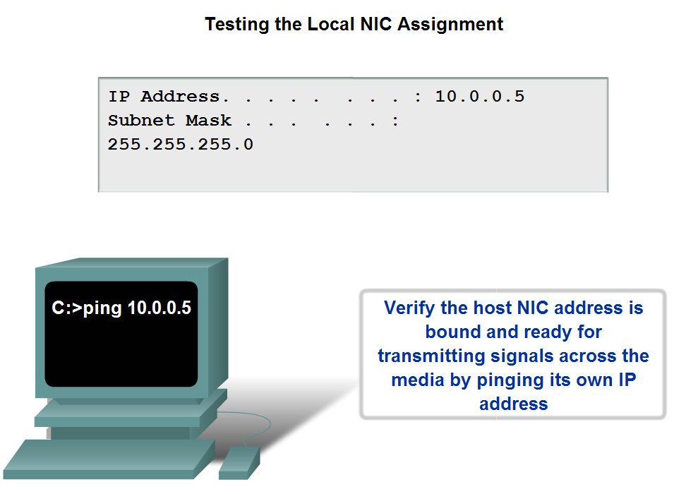
Use Common Utilities to Verify Network Connectivity Between Hosts
Use the ping command to determine if the IP protocol is properly bound to an NIC

Slide 50
Testing the NIC
The next step in the testing sequence is to verify that the NIC address is bound to the IPv4 address and that the NIC is ready to transmit signals across the media.
In this example, also shown in the figure, assume that the IPv4 address assigned to a NIC is 10.0.0.5.
To verify the IPv4 address, use the following steps:
At the command line, enter the following:
C:\>ping 10.0.0.5
This test verifies that the NIC driver and most of the NIC hardware are working properly. It also verifies that the IP address is properly bound to the NIC, without actually putting a signal on the media.
If this test fails, it is likely that there are issues with the NIC hardware and software driver that may require reinstallation of either or both.

Slide 51
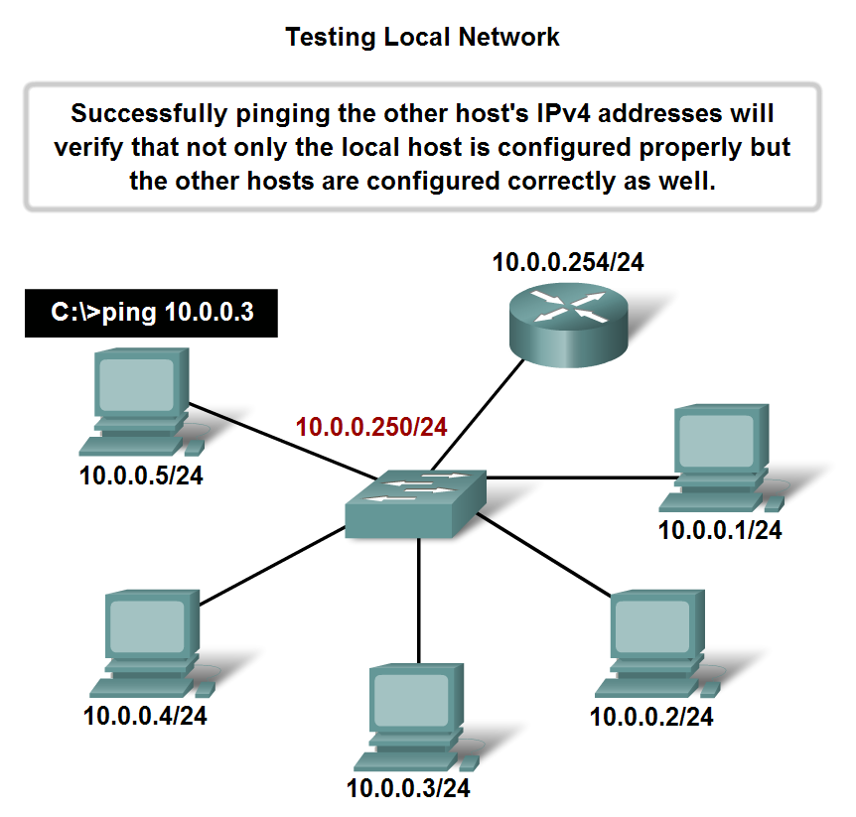
Use Common Utilities to Verify Network Connectivity Between Hosts
Use the ping command to determine if a host can actively communicate across the local network

Slide 52
Testing the Local LAN
The next test in the sequence is to test hosts on the local LAN.
Successfully pinging remote hosts verifies that both the local host (the router in this case) and the remote host are configured correctly. This test is conducted by pinging each host one by one on the LAN.
See the figure for an example.
Extended Ping:
To examine this the IOS offers an "extended" mode of the ping command. This mode is entered by typing ping in privileged EXEC mode, at the CLI prompt without a destination IP address. A series of prompts are then presented as shown in this example. Pressing Enter accepts the indicated default values.

Slide 53
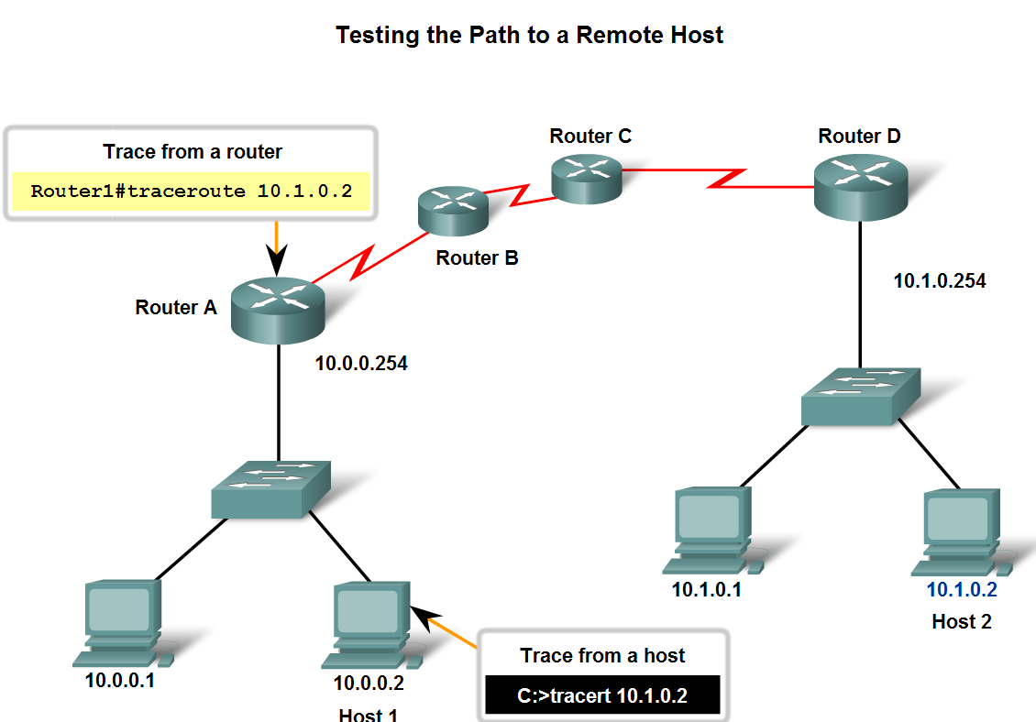
Use Common Utilities to Verify Network Connectivity Between Hosts
Use the ping command to verify that the local host can communicate across the internetwork to a given remote host.

Slide 54
Tracert and Ping
The next step in the testing sequence is to perform a trace.
A trace returns a list of hops as a packet is routed through a network. The form of the command depends on where the command is issued.
When performing the trace from a Windows computer, use tracert. When performing the trace from a router CLI, use traceroute.
Ping and trace can be used together to diagnose a problem.
Let's assume that a successful connection has been established between Host 1 and Router A, as shown in the figure.
Next, let's assume that Host 1 pings Host 2 using this command.
C:\>ping 10.1.0.2

Slide 55
Ping Results
The ping command returns this result:
Pinging 10.1.0.2 with 32 bytes of data:
Request timed out.
Ping statistics for 10.1.0.2:
Packets: Sent = 4, Received = 0, Lost = 4 (100% loss)
The ping test failed.
This is a test of communication beyond the local network to a remote device.
Because the local gateway responded but the host beyond did not, the problem appears to be somewhere beyond the local network.
A next step is to isolate the problem to a particular network beyond the local network. The trace commands can show the path of the last successful communication.

Slide 56
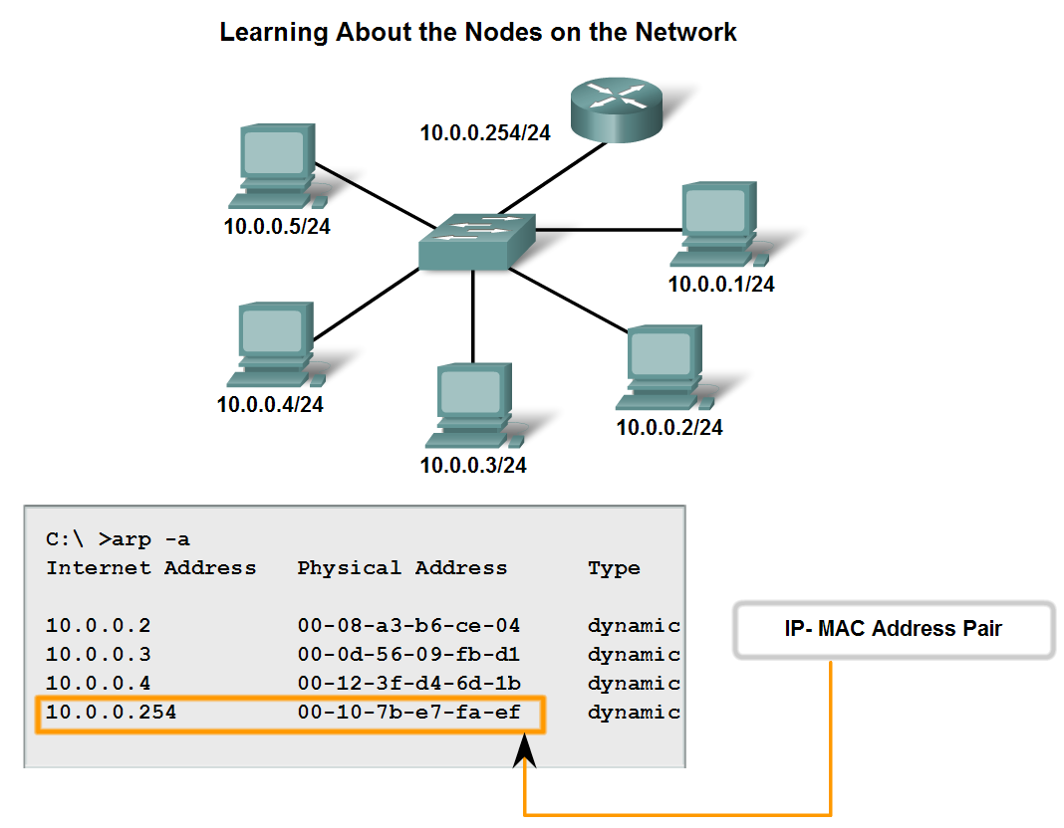
Use Common Utilities to Establish a Relative Performance Baseline for the Network
Trace the steps for verifying the physical addresses of the hosts

Slide 57
ARP Command
The arp command provides for the mapping of physical addresses to known IPv4 addresses.
A common method for executing the arp command is to execute it from the command prompt.
This method involves sending out an ARP request.
The device that needs the information sends out a broadcast ARP request to the network, and only the local device that matches the IP address of the request sends back an ARP reply containing its IP-MAC pair.
To execute an arp command, at the command prompt of a host, enter:
C:\host1>arp –a
As shown in the figure the arp command lists all devices currently in the ARP cache, which includes the IPv4 address, physical address, and the type of addressing (static/dynamic), for each device.

Slide 58
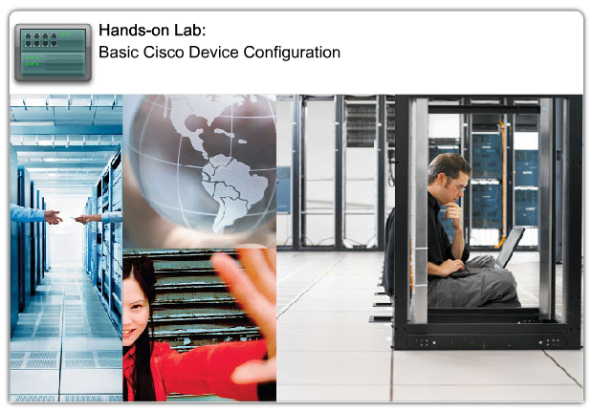
Labs

Slide 59
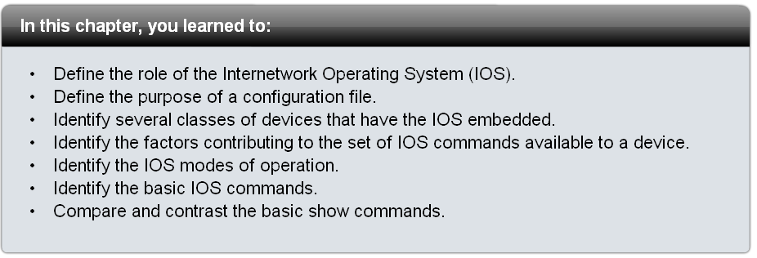
Summary

